Slide 1
Diffusion based Model Predictive Control
PRESENTED BY Amey Joshi, and Raman Jha
05/24/2025

Slide 2
Motivation: Bridging Gaps in Model-Based Offline RL
Prior model-based offline planning methods like MBOP learn single-step dynamics and action proposals, suffering from compounding errors over long horizons
Deep and recurrent neural networks may lack a deeper understanding of the problem domain and can be inflexible when tasks or reward functions change
Existing diffusion-based world models within the Dynamics model framework are unable to plan at run-time
Methods like Diffuser struggle to adapt to changes in the world from small amounts of new data
Decision Diffuser does not allow for run-time specification of new reward functions
Model-based RL methods using MPC, such as TD-MPC and TD-MPC2, often rely on single-step MLPs, potentially facing compounding errors

Slide 3
Background: Leveraging MPC and Generative Models
D-MPC is inspired by Model Predictive Control (MPC), a control strategy powerful in practice. MPC involves learning a dynamics model and using a planner to optimize action sequences.
The approach can be seen as a multi-step diffusion extension of Model-Based Offline Planning (MBOP).
D-MPC utilizes diffusion models, which have shown impressive results across various modalities.
The method learns from offline trajectory datasets of (state, action, reward) triples.
It relates to previous work in model-based offline planning, diffusion-based world modeling and planning, and MPC applications in model-based RL like the TD-MPC line of work.

Slide 4
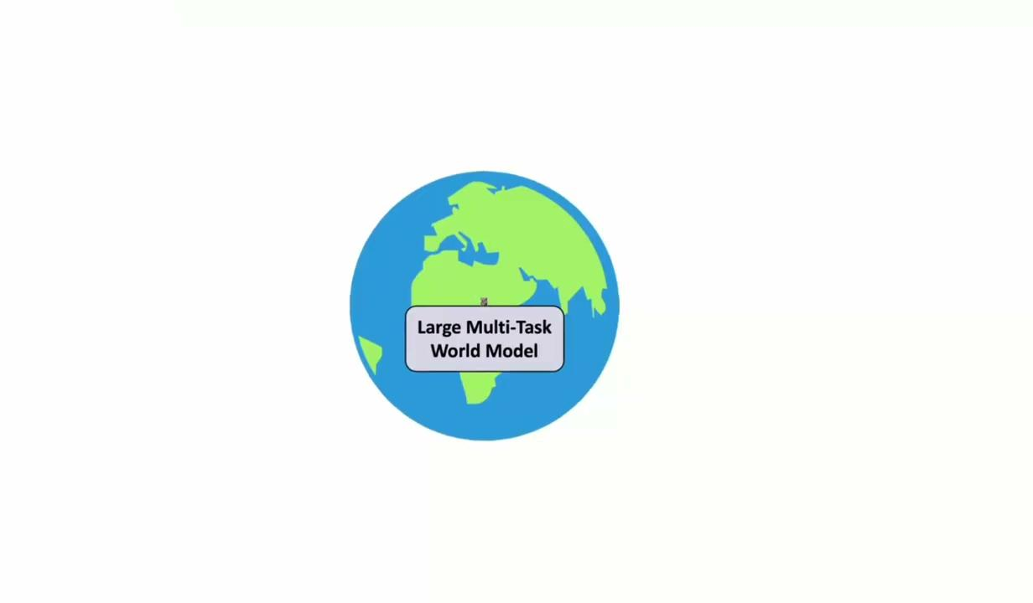
Problems: The Challenge of Long Horizons and Adaptability
A core problem is the compounding error that arises when chaining single-step model predictions over long planning horizons
Many prior methods lack the ability to adapt to novel reward functions or dynamics encountered at test time
Existing diffusion-based methods may have different mechanisms for steering generation, such as classifier-guidance, which differs from D-MPC's planning approach.
Runtime speed is a challenge for diffusion models compared to faster, simpler models like MLPs

Slide 5
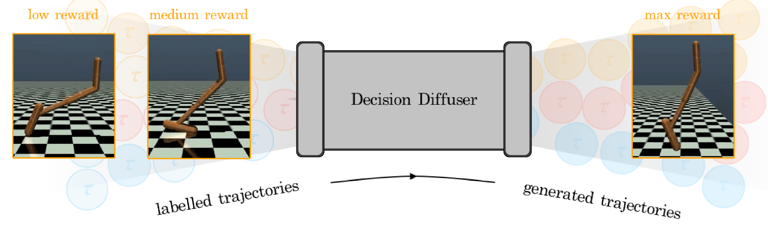
Model Predictive Control (MPC): An Overview
MPC plans a sequence of future actions to optimize an objective
It typically involves learning a dynamics model and using a planner to find optimal actions
D-MPC integrates MPC by first learning models offline and then cycling through taking an action and planning the next sequence in the environment
The concept of Differentiable MPC allows learning MPC policies end-to-end by differentiating through the optimization, though D-MPC uses a different planning approach
Diffusion Dynamics

Slide 6
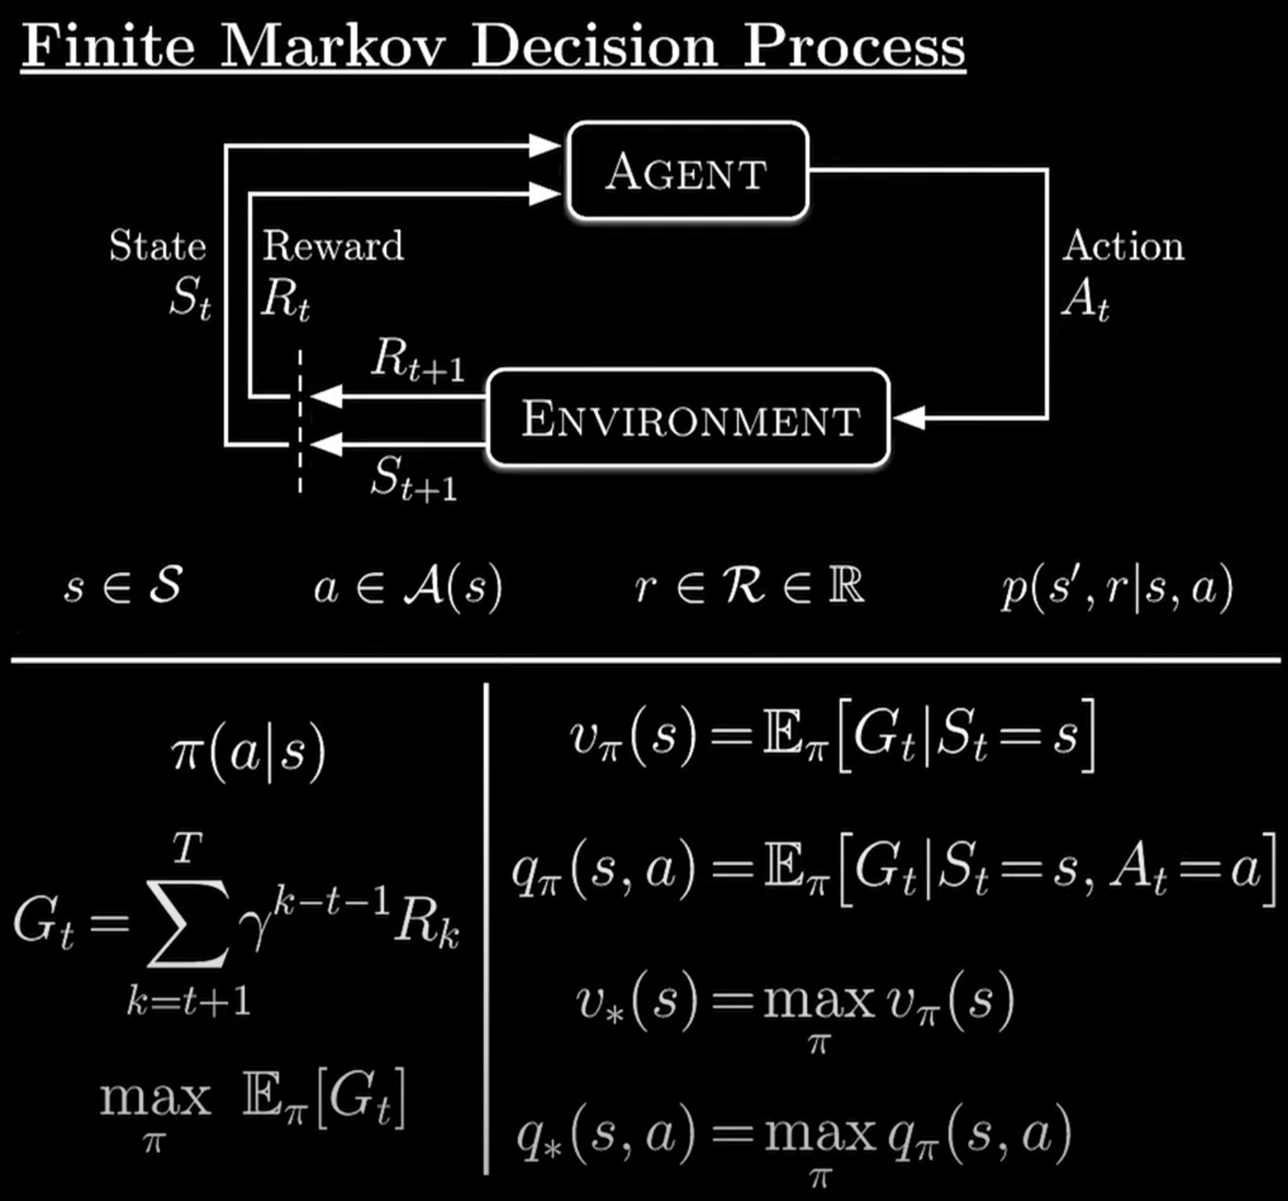
Environment Setup Overview
Let us define the key dimensions used throughout:
B: Batch size from configuration (cfg.batch_size)
H: Planning horizon (cfg.horizon)
O: Observation dimension (derived from cfg.obs_shape)
A: Action dimension (cfg.action_dim)
Z: Latent state dimension (cfg.latent_dim, typically ≥ 50)
T: Sequence length sampled from buffer (usually H+1

Slide 7
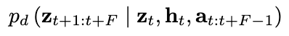
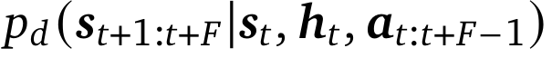
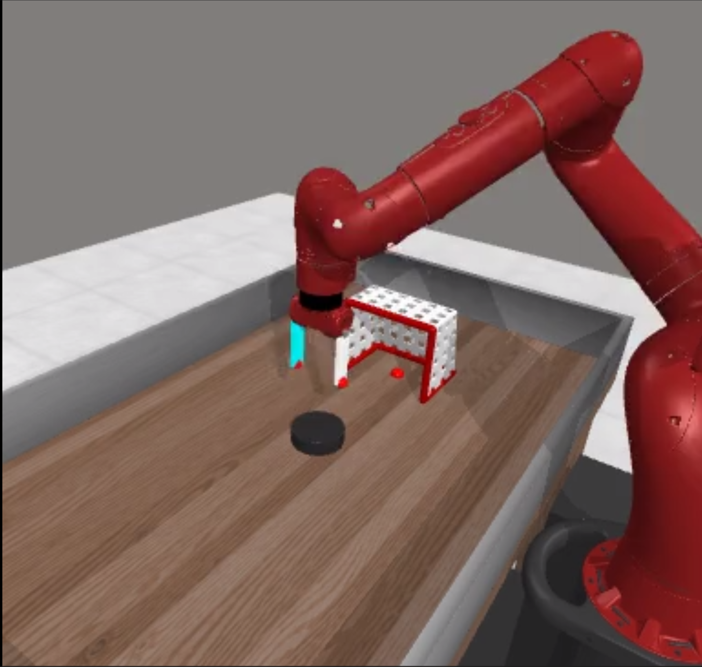
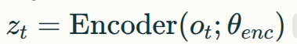
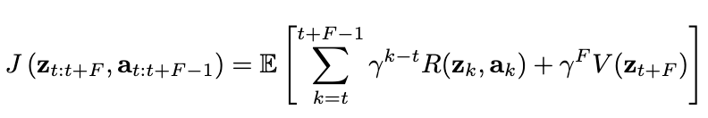
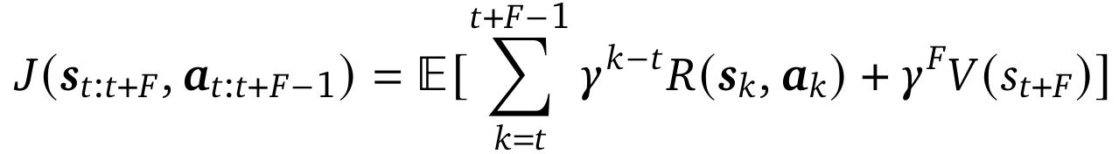
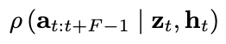
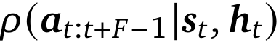
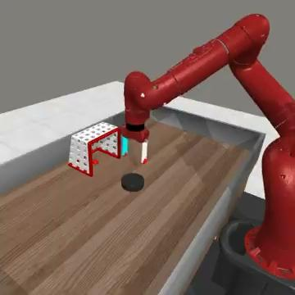
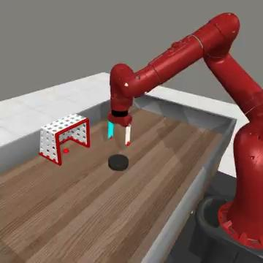
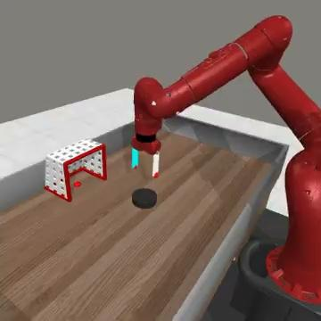
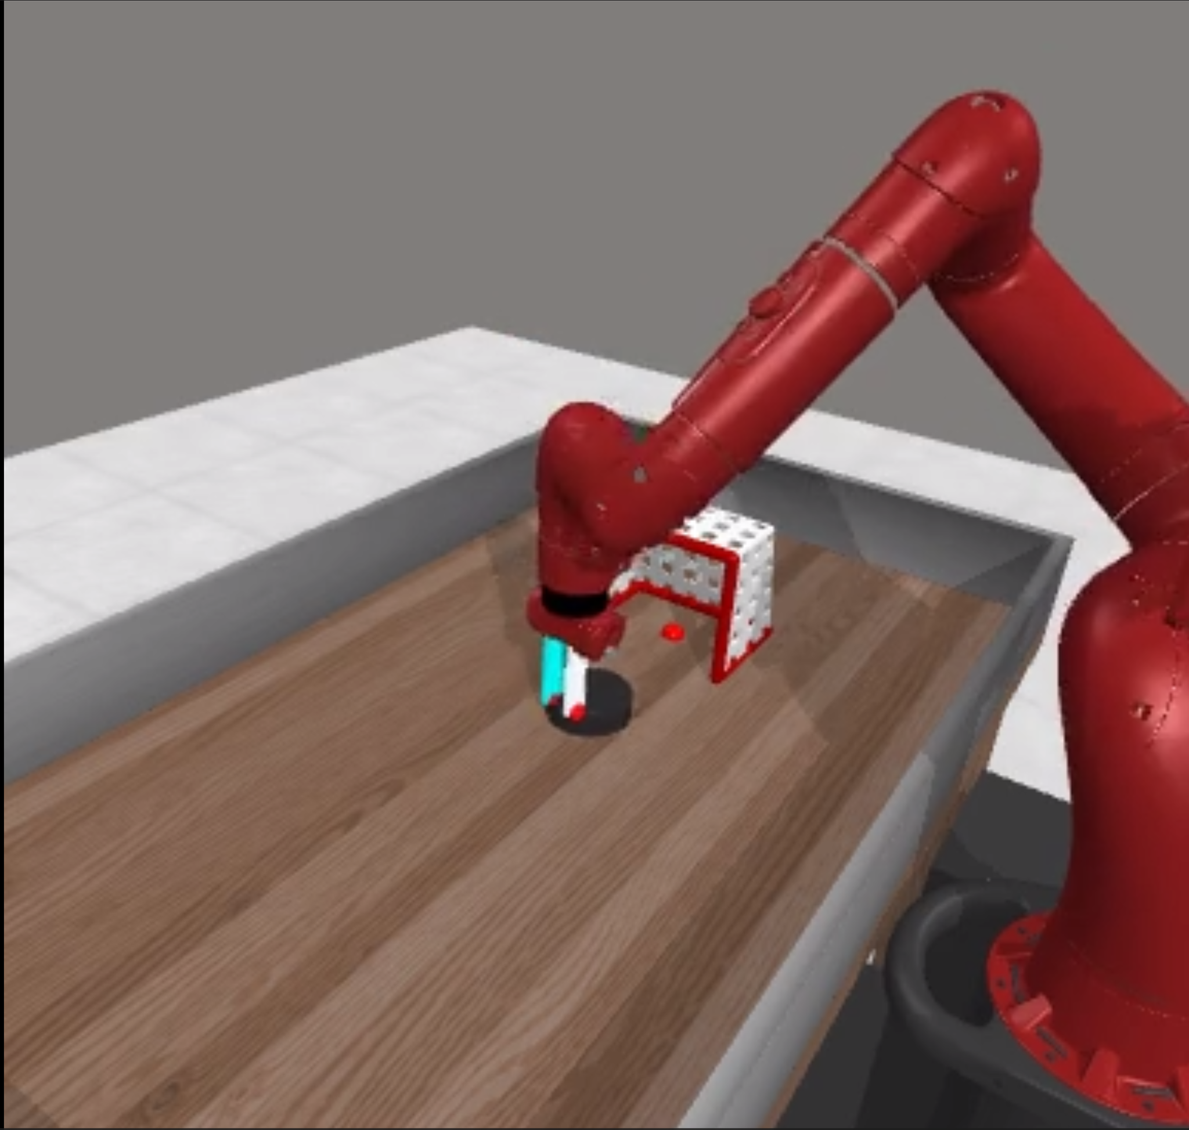
D-MPC: Diffusion-Based MPC Approach
Dynamics model
reward
Action
State
Reward to Go
Action Proposal
SSR Planner

Slide 8
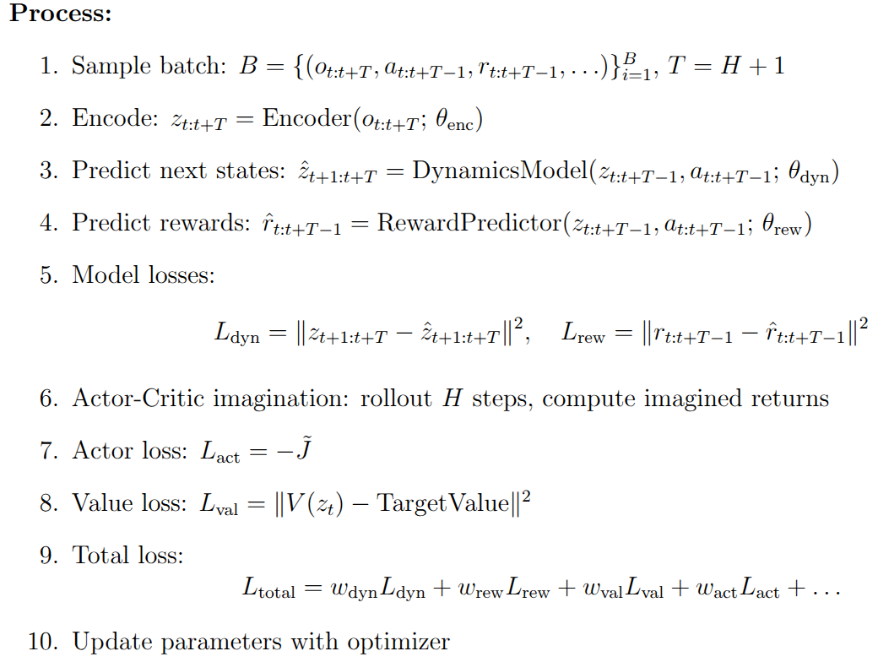
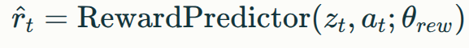
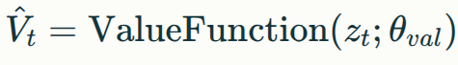
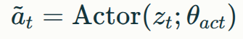
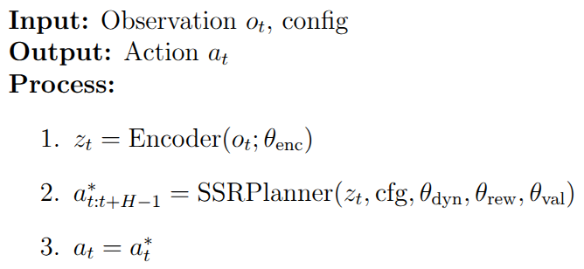
Architecture & Model Learning
DMPCTrainer:
DMPCAgent:

Slide 9
Architecture & Model Design Choices
Diffusion Models for System Dynamics
Core Concept: Utilizing diffusion models to learn complex system dynamics from data.
Hypothesized Advantage vs. Causal Models: A-causal nature (noise-to-clean trajectory generation) conjectured to capture global sequence properties more effectively than traditional causal models.
Diffusion Models for Action Proposal Generation
Core Concept: Employing diffusion models as powerful generative tools for action sequences in planning/control.
Key Capability: Effectively models complex, multimodal distributions inherent in diverse demonstration datasets (critical for imitation learning).
Benefit: Captures multiple valid ways to perform a task learned from offline data.
Advantage - Temporal Consistency: Representing actions as high-dimensional sequences via diffusion naturally encourages temporal coherence.

Slide 10
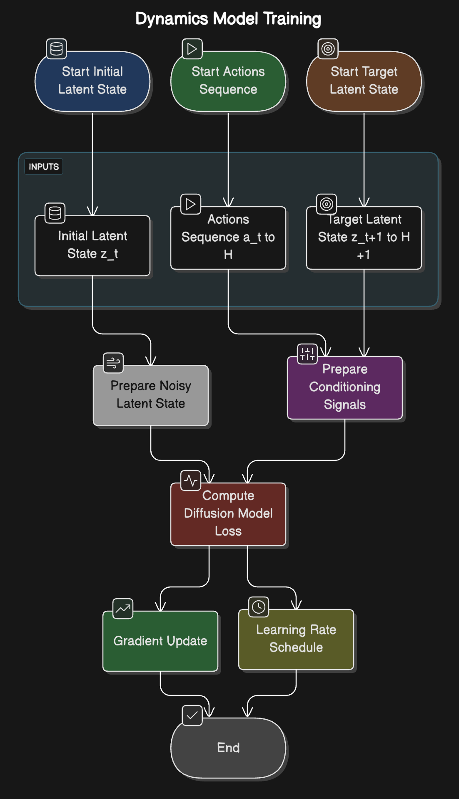
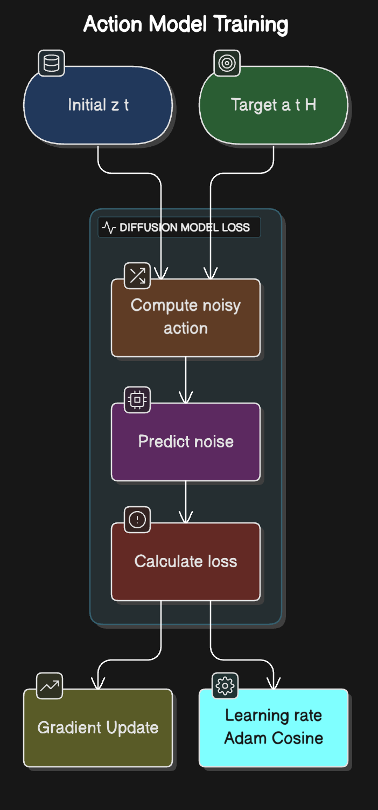
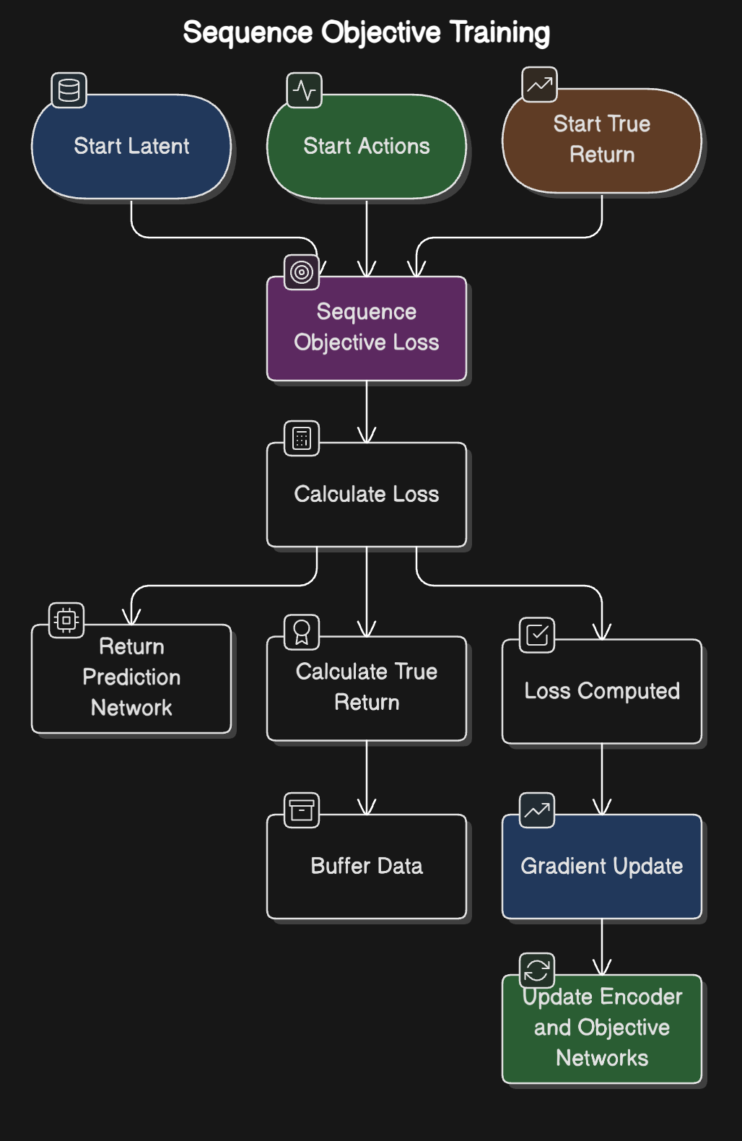
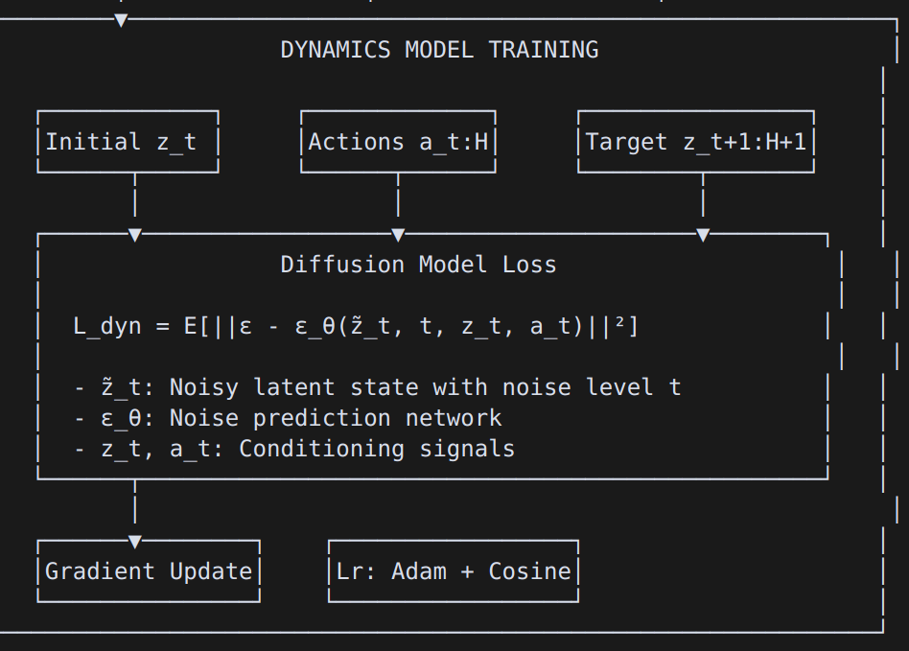
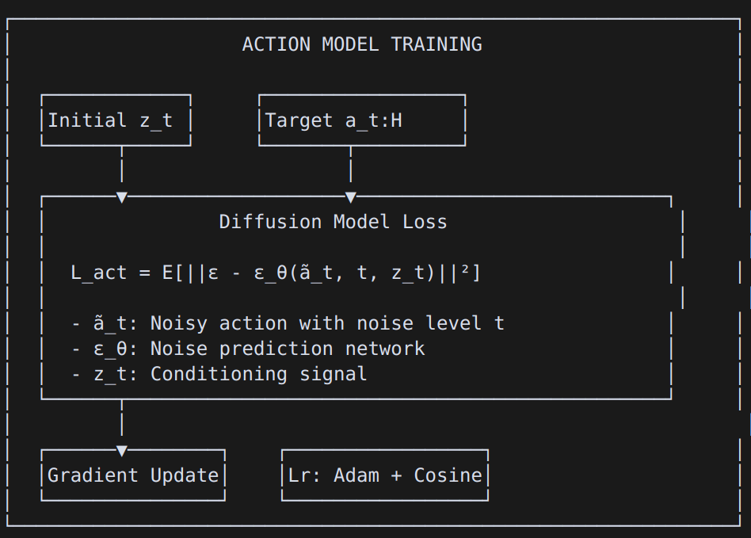
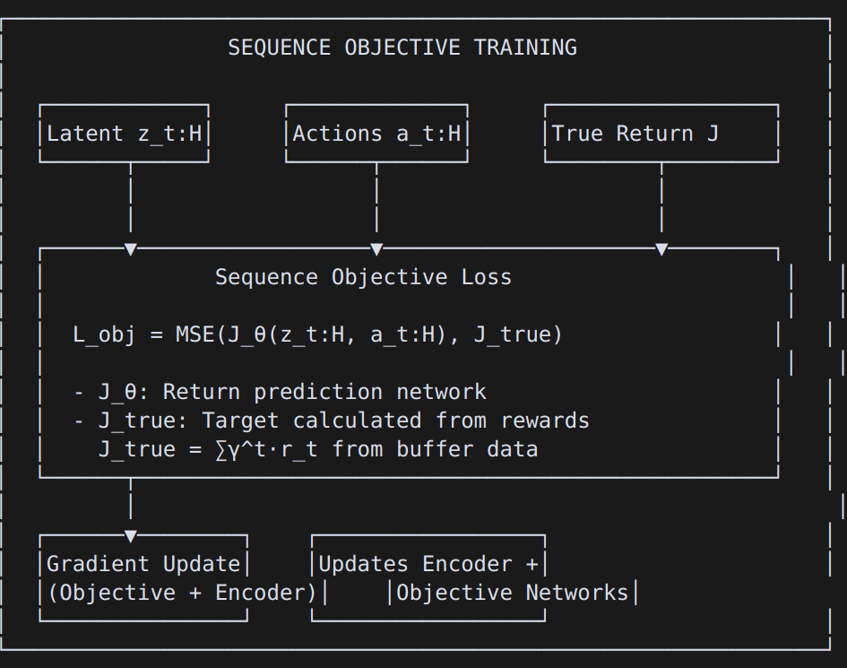
Architecture & Model Design Choices

Slide 11
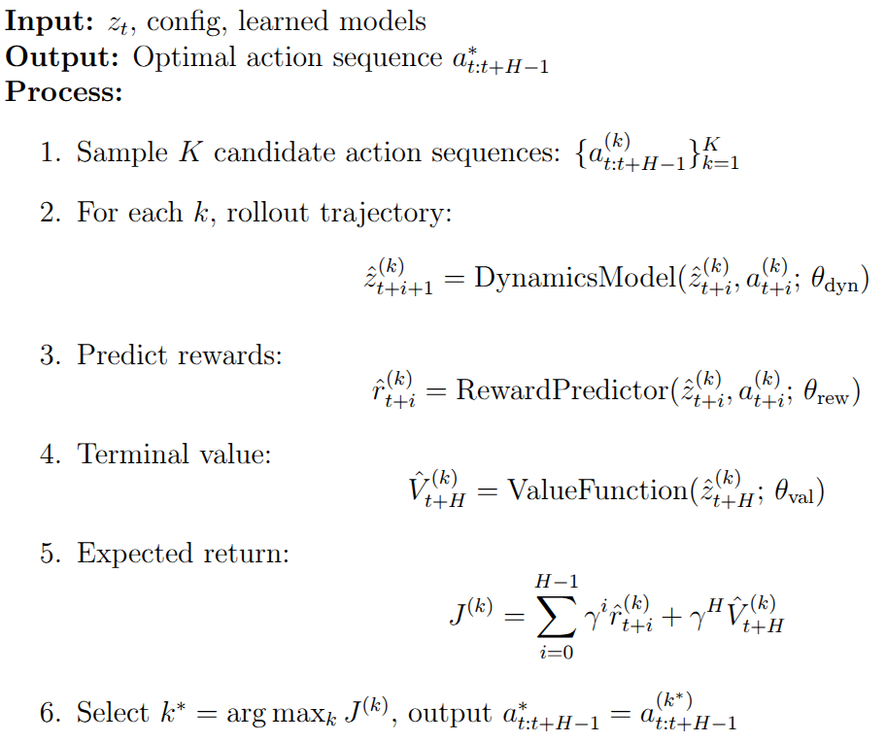
SSR Planner (Stochastic Shooting/Sampling-Based Planner

Slide 12
Experimental Evaluation & Results
Multi task training on 10 MW-Tasks:
‘Mw-assembly', 'mw-basketball', 'mw-button-press-topdown', 'mw-button-press-topdown-wall', 'mw-button-press','mw-button-press-wall', 'mw-coffee-button', 'mw-coffee-pull', 'mw-door-open', 'mw-door-close', 'mw-drawer-close', 'mw-drawer-open'
Single NVIDIA GeForce RTX 4080 on 50K steps
Model | Domain | params | Normalized score | GPU Days
TD-MPC2 | Meta World-10 | 48 M | 31.2 | 1.8
D-MPC (ours) | Meta-world-10 | 27 M | 29.78 | 3.4

Slide 13
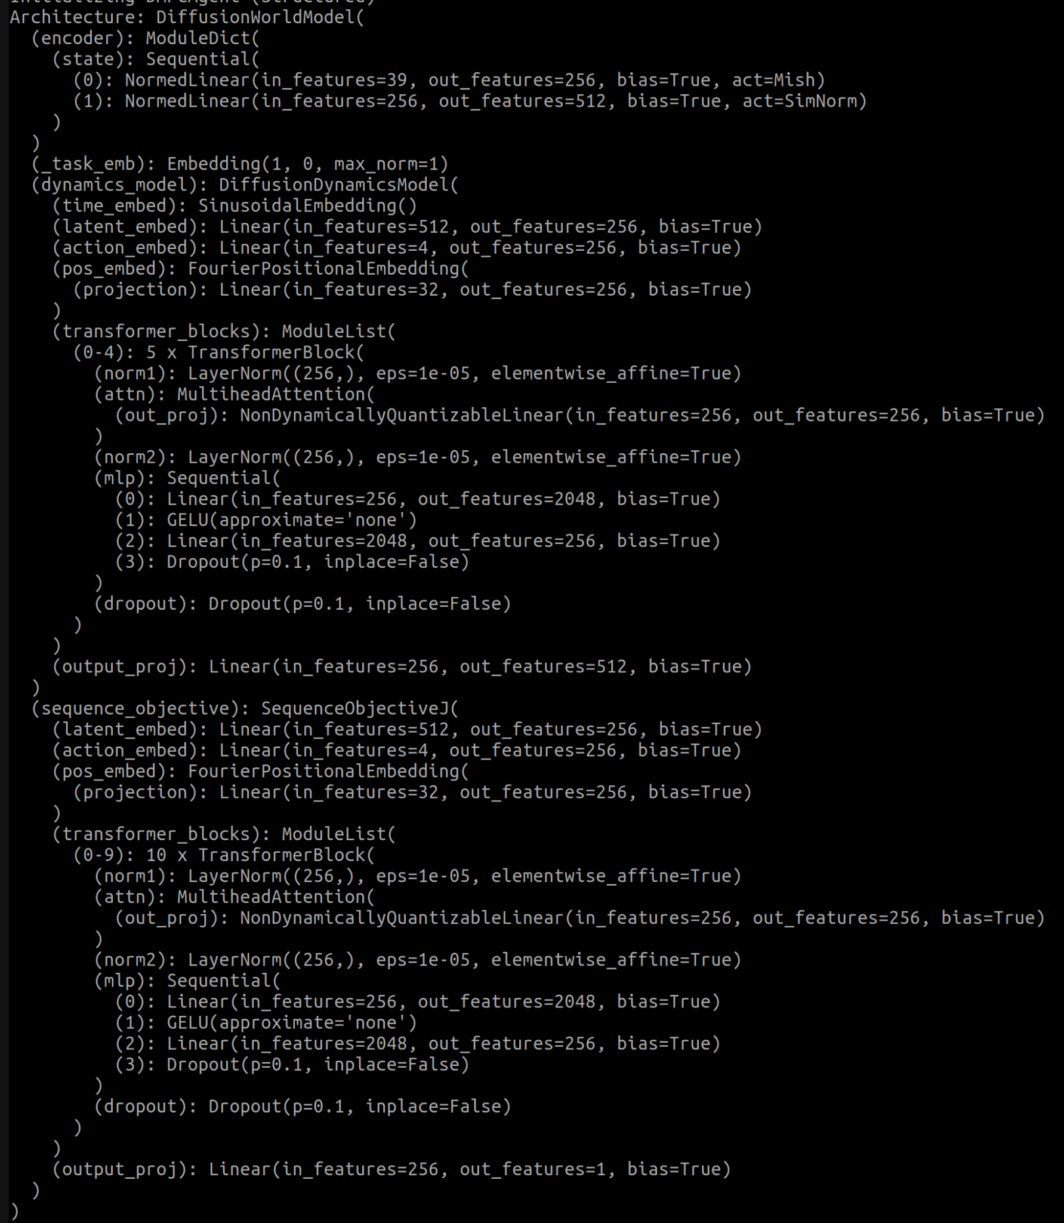
Experimental Evaluation & Results
Model Architecture
latent_dim: 50
action_dim: 4
history_len: 3
task_dim: 32
Diffusion Configuration
dmpc_num_samples: 64
dmpc_action_inference_steps: 32
dmpc_dynamics_inference_steps: 10
Training Parameters
batch_size: 512 # Batch size for training
horizon: 4 # Planning/sequence horizon (H)
lr: 1e-4 # Learning rate
lr_warmup_steps: 500 # LR warmup period
ema_decay: 0.99 # EMA model parameter decay
grad_clip_norm: 10.0 # Gradient clipping threshold
discount: 0.99 # Reward discount factor

Slide 14
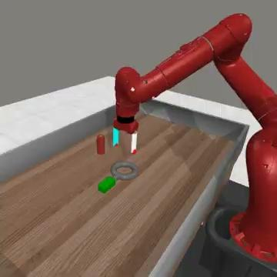
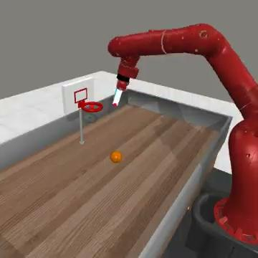
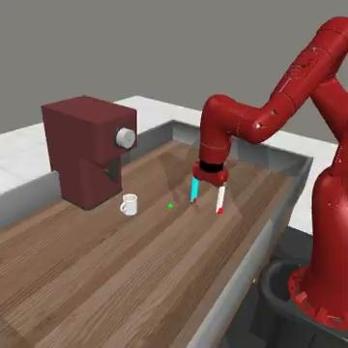
Experimental Evaluation & Results
mw-assembly
mw-basketball
mw-coffee-pull

Slide 15
Test-Time Adaptation via Dynamics Fine-Tuning
Core Hypothesis: Propose to validate the efficacy of adapting to novel system dynamics (e.g., arising from hardware defects, wear-and-tear) at test time.
Proposed Mechanism: Investigate targeted fine-tuning of the pre-trained, factorized multi-step diffusion dynamics model (p(s|a)) using limited interaction data collected under the novel dynamics.
Key Enabling Factor: Leverage the inherent separation of the dynamics model from the action proposal (π(a)) and value functions within the framework (e.g., D-MPC).
Hypothesized Benefit: Allows isolated adaptation of the world model without disrupting the learned policy or value estimates.
Question to answer: Quantify the data efficiency – how effectively can performance be recovered with minimal (e.g., << 100 episodes) interaction data under the new dynamics?
Experimental Design:
Train baseline models (dynamics, policy, value) on standard simulation data.
Introduce specific, quantifiable dynamics shifts post-training (e.g., actuator limitations, friction changes, mass variations).
Collect a small dataset ("play data") via interaction with the perturbed environment using the original policy.
Apply fine-tuning exclusively to the diffusion dynamics model using this limited data.
Evaluate performance recovery on the perturbed environment post-fine-tuning.

Slide 16
Conclusion: Key Contributions and Performance
D-MPC successfully integrates multi-step diffusion models for both dynamics prediction and action proposal generation within a novel MPC framework for offline data.
Logically mitigates compounding errors
Enables runtime reward optimization
Facilitates efficient dynamic adaptation
Highlight the synergy between the logical design choices (multi-step, factorization, diffusion, SSR) and the strong empirical outcomes.

Slide 17
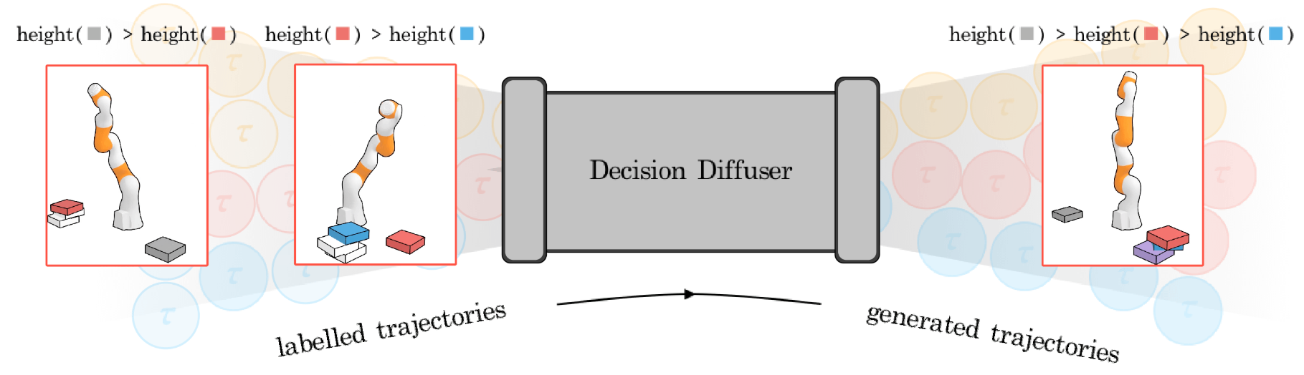
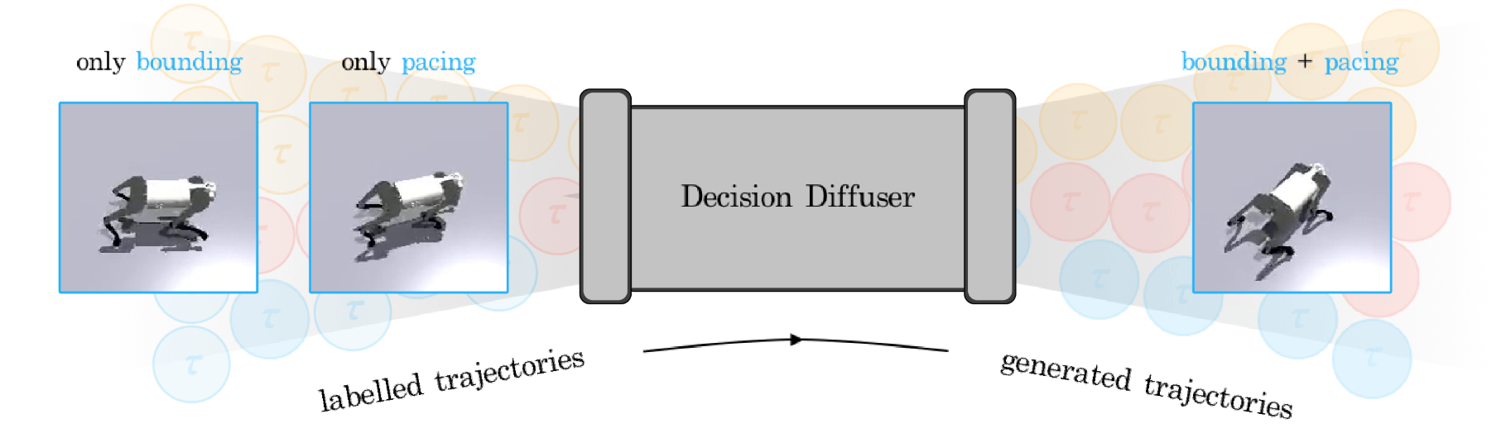
Future Scope and Testing
Given trajectories satisfying single constraint, Can we generate trajectories with multiple constraints ?
Diffusion Dynamics
Given trajectories demonstrating only one skill, Can we generate trajectories with composed skills ?
Diffusion Dynamics

Slide 18
Limitations and Improvement Areas:
Higher computational requirements than TD-MPC2
Sampling efficiency could be improved via distillation or guided diffusion
Inference speed optimizations needed for real-time deployment

Slide 19
Q & A.!

